Slide 1
Digital Image Processing
Associate Prof. Zhang Qingfeng(张庆丰)
Department of Computer Science, Jinan University
Office Room: 415, Nanhailou Building
Email: zqf135@qq.com
1

Slide 2
Chapter 4
Filtering in the frequency Domain (II)
2

Slide 3
Contents
Basics of filtering in the frequency domain
Image smoothing using frequency domain filters
Image sharpening using frequency domain filters
Selective filtering
Summary
Homework
3

Slide 4
Basics of filtering in the frequency domain
Additional Characteristics of the Frequency Domain
From
Each term of F(u,v) contains all values of f(x,y), modified by the values of the exponential terms. Thus, it usually is impossible to make direct associations between specific components of an image and its transform.

Slide 5
Basics of filtering in the frequency domain
However, some general statements can be made about the relationship between the frequency components of the Fourier transform and spatial features of an image.
The low frequencies correspond to the slowly varying intensity components of an image.
The high frequencies correspond to the fast intensity changes in the image. These are the edges of objects and other components of an image characterized by abrupt changes in intensity.

Slide 6
Basics of filtering in the frequency domain
Filtering techniques in the frequency domain are based on modifying the Fourier transform to achieve a specific objective and then computing the inverse DFT to get us back to the image domain.
The two components of the transform to which we have access are the transform magnitude (spectrum) and the phase angle.
The spectrum provides some useful guidelines as to gross characteristics of the image

Slide 7
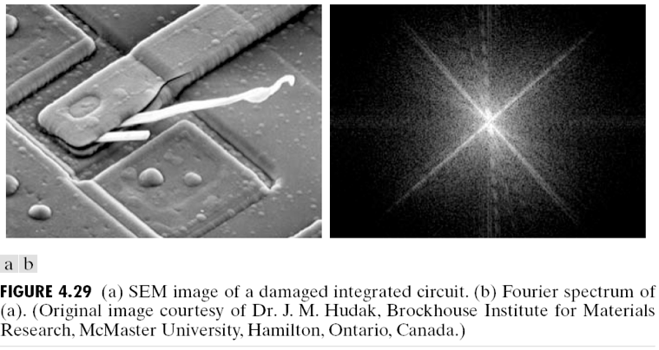
Basics of filtering in the frequency domain

Slide 8
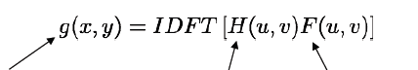
Basics of filtering in the frequency domain
Frequency Domain Filtering Fundamentals
Given a digital image f(x,y) of size MxN, the basic filtering equation is:
NB: For simplification, use functions H(u,v) that are centered symmetric about their centre. Requires that F(u,v) be centered also, this is accomplished by multiplying f(x,y) by (-1)^{x+y}
NB: product =
array multiplication
Filtered (output) image
Filter function (or filter transfer function)
DFT of the input image
Notes:
It is called Fourier series

Slide 9
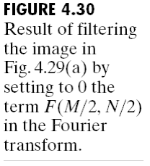
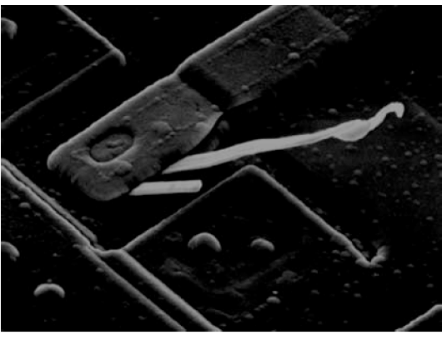
Basics of filtering in the frequency domain
Consider the filtering process in some detail. One of the simplest filters is:
This filter would reject the dc term and “pass” all other terms of F(u,v) when we form the product H(u,v)F(u,v).

Slide 10
Basics of filtering in the frequency domain
A filter H(u,v) that attenuates(减弱) high frequencies while passing low frequencies (called a lowpass filter 低通滤波器) would blur an image. While a filter with the opposite property (called a highpass filter 高通滤波器) would enhance sharp detail, but cause a reduction in contrast in the image.

Slide 11
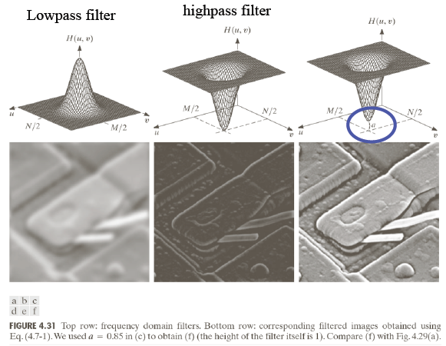
Basics of filtering in the frequency domain

Slide 12
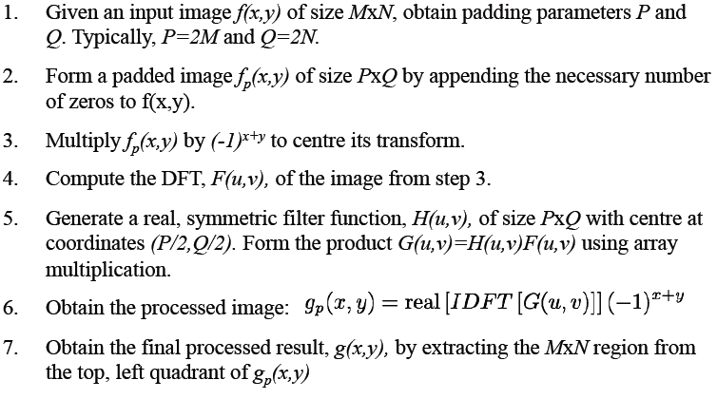
Basics of filtering in the frequency domain
Steps for Filtering in the Frequency Domain

Slide 13
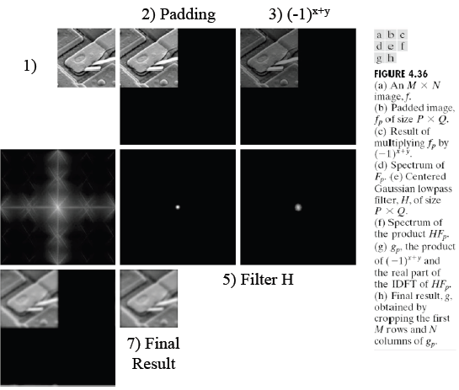
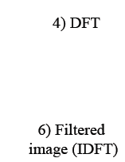
Basics of filtering in the frequency domain

Slide 14
Basics of filtering in the frequency domain
Correspondence between Filtering in the Spatial and Frequency Domain
Let H(u) denote a frequency domain, Gaussian filter function given the equation
where : the standard deviation of the Gaussian curve.
The corresponding filter in the spatial domain is
Note: Both the forward and inverse Fourier transforms of a Gaussian function are real Gaussian functions.
14

Slide 15
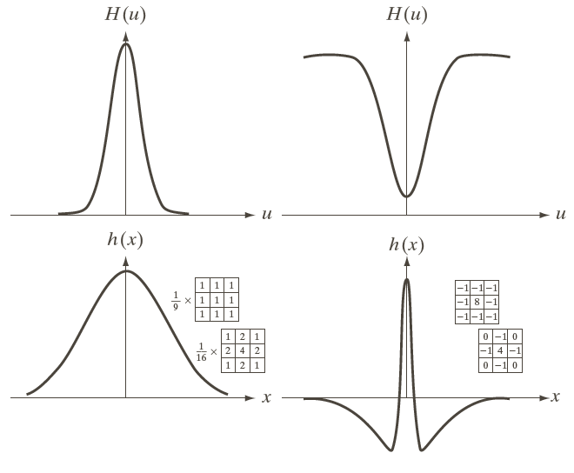
Basics of filtering in the frequency domain
15

Slide 16
Basics of filtering in the frequency domain
One very useful property of the Gaussian function is that both it and its Fourier transform are real valued; there are no complex values associated with them.
In addition, the values are always positive. So, if we convolve an image with a Gaussian function, there will never be any negative output values to deal with.
There is also an important relationship between the widths of a Gaussian function and its Fourier transform. If we make the width of the function smaller, the width of the Fourier transform gets larger. This is controlled by the variance parameter σ² in the equations.
16

Slide 17
Basics of filtering in the frequency domain
These properties make the Gaussian filter very useful for lowpass filtering an image. The amount of blur is controlled by σ². It can be implemented in either the spatial or frequency domain.
Other filters besides lowpass can also be implemented by using two different sized Gaussian functions.
17

Slide 18
Image Smoothing using Frequency Domain Filters
The basic model for filtering in the frequency domain
where F(u,v): the Fourier transform of the image to be smoothed
H(u,v): a filter transfer function
Smoothing is fundamentally a lowpass operation in the frequency domain.
There are several standard forms of lowpass filters (LPF).
Ideal lowpass filter
Butterworth lowpass filter
Gaussian lowpass filter
18

Slide 19
Ideal Lowpass Filters (ILPFs)
The simplest lowpass filter is a filter that “cuts off” all high-frequency components of the Fourier transform that are at a distance greater than a specified distance D₀ from the origin of the transform.
The transfer function of an ideal lowpass filter
where D(u,v) : the distance from point (u,v) to the center of the frequency rectangle
19

Slide 20
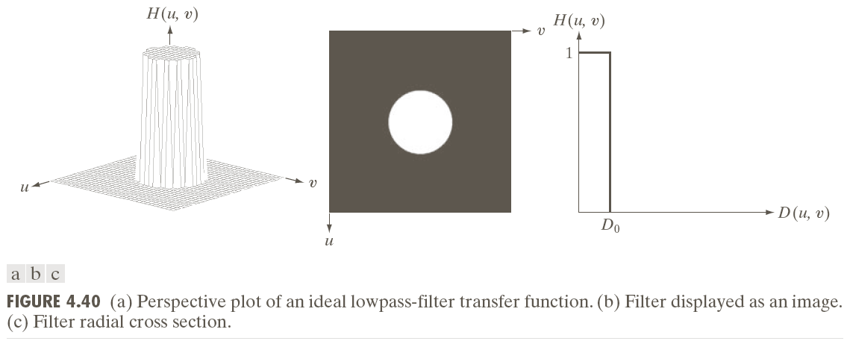
Ideal Lowpass Filters (ILPFs)
The point of transition between H(u,v) = 1 and H(u,v) = 0 is called the cutoff frequency(截止频率).
20

Slide 21
Ideal Lowpass Filters (ILPFs)
21

Slide 22
Result of filtering
with ideal low
pass filter of
Radius 10
Original
image
Result of filtering
with ideal low
pass filter of
Radius 30
Result of filtering
with ideal low
pass filter of
radius 60
Result of filtering
with ideal low
pass filter of
Radius 160
Result of filtering
with ideal low
pass filter of
radius 460
22

Slide 23
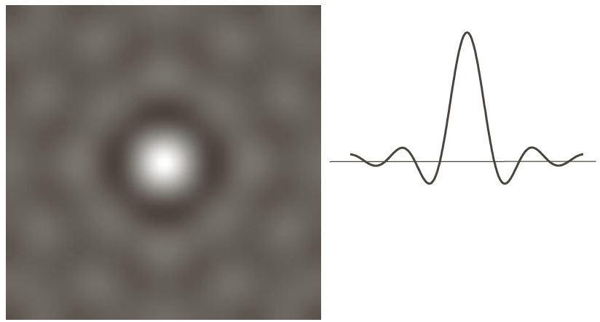
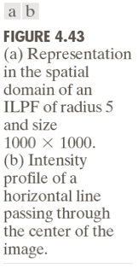
Blurring and Ringing Properties

Slide 24
Butterworth Lowpass Filters (BLPFs)
It was proposed by the British engineer Stephen Butterworth
Filter order can change the shape of the Butterworth filter; for high order values, the Butterworth filter approaches the ideal filter; for low order values, it approaches the Gaussian filter
Transfer function of a Butterworth lowpass filter (BLPF) of order n and with cutoff frequency at a distance D₀ from the origin:
24

Slide 25
Butterworth Lowpass Filters (BLPFs)
25

Slide 26
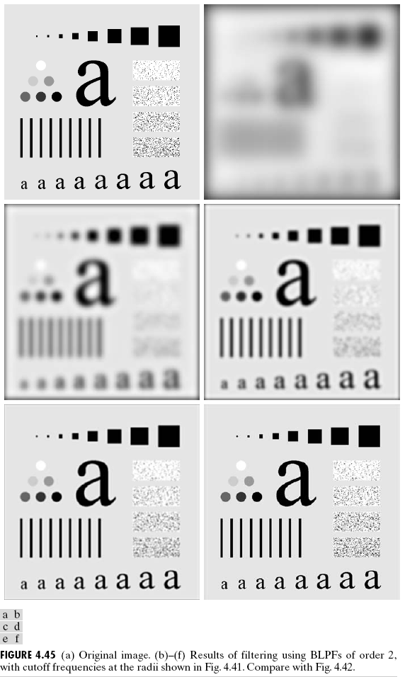
Butterworth Lowpass Filters (BLPFs)
n=2
D₀=10, 30, 60, 160, and 460
26

Slide 27
Butterworth Lowpass Filters (BLPFs)
27

Slide 28
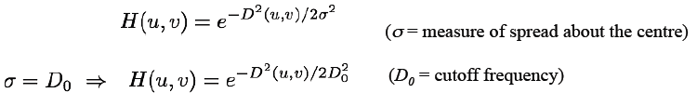
Gaussian Lowpass Filters (GLPFs)
Gaussian Lowpass Filters (GLPFs) in two-dimensions
28

Slide 29
Gaussian Lowpass Filters (GLPFs)
D₀=5,15,30,80,and 230
29

Slide 30
Gaussian Lowpass Filters (GLPFs)
30

Slide 31
Additional Examples of Lowpass Filtering
Character recognition (machine perception):
31
Blurring to fill “visual gaps” => help reading broken characters

Slide 32
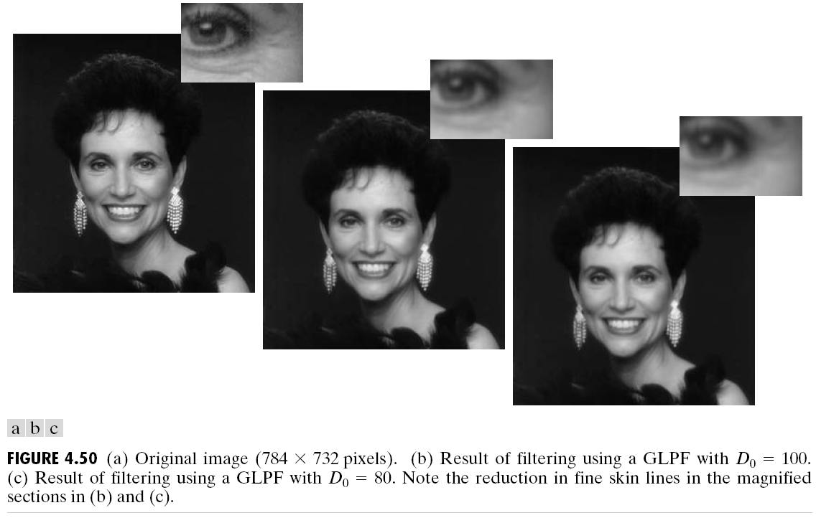
Additional Examples of Lowpass Filtering
Gaussian filters used to remove blemishes(瑕疵) in a photograph for publishing
32

Slide 33
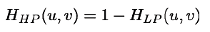
Image Sharpening using Frequency Domain Filters
Image Sharpening can be achieved in the frequency domain by a highpass filtering process
Attenuate(减弱) the low-frequency components
Preserve the high-frequency components
The transfer fucntion of a highpass filter H_{HP} can be obtained from a given lowpass filter H_{LP} by:
33

Slide 34
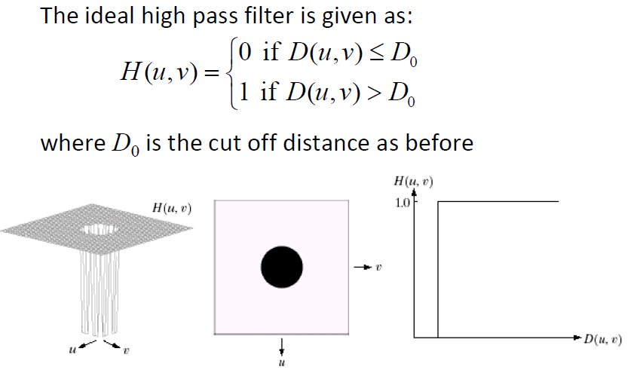
Image Sharpening using Frequency Domain Filters
34

Slide 35
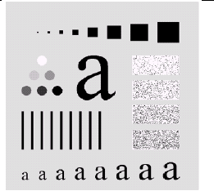
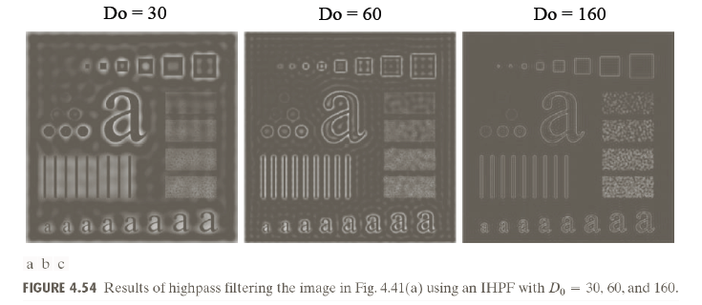
Image Sharpening using Frequency Domain Filters
Example of IHPF
35

Slide 36
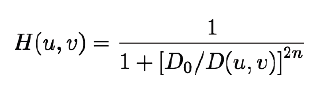
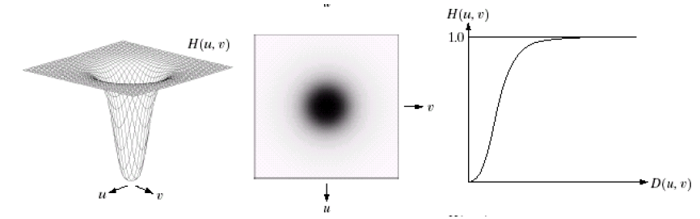
Image Sharpening using Frequency Domain Filters
Butterworth Highpass Filters (BHPF)
The transfer function of the Butterworth highpass filter (BHPF) of order n, and with cutoff frequency at distance D₀ from the origin is given by
36

Slide 37
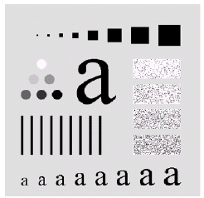
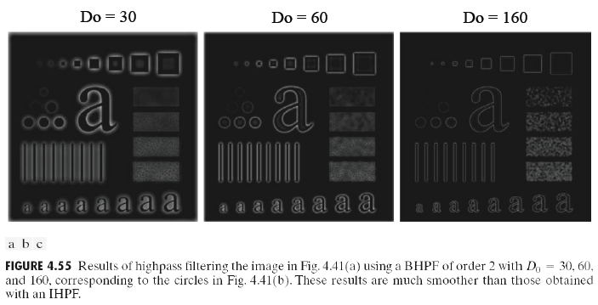
Image Sharpening using Frequency Domain Filters
Example of BHPF
37

Slide 38
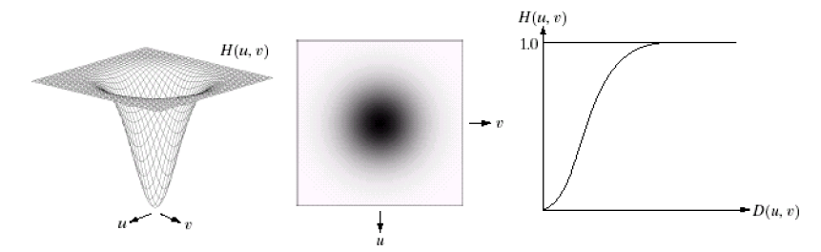
Image Sharpening using Frequency Domain Filters
Gaussian Highpass Filters (GHPF)
The transfer function of the Gaussian Highpass Filter (GHPF) with cutoff frequency locus at a distance D₀ from the centre of the frequency rectangle is defined as:
38

Slide 39
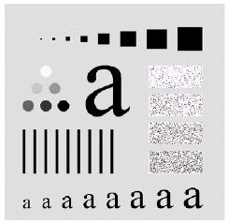
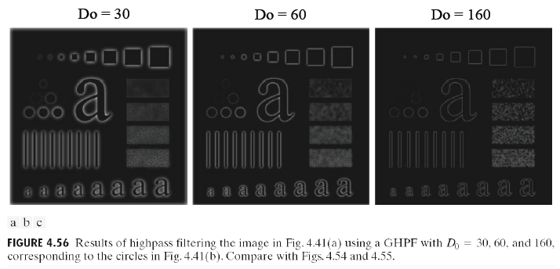
Image Sharpening using Frequency Domain Filters
Example of GHPF
39

Slide 40
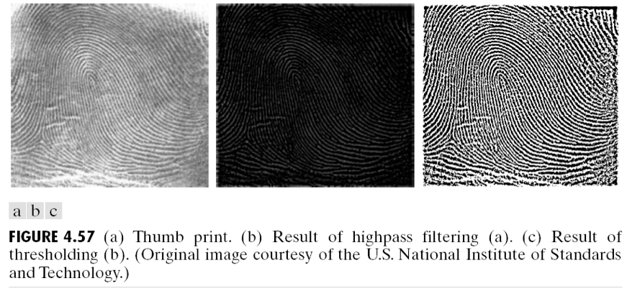
Image Sharpening using Frequency Domain Filters
Example: using highpass filtering and thresholding for image enhancement
40

Slide 41
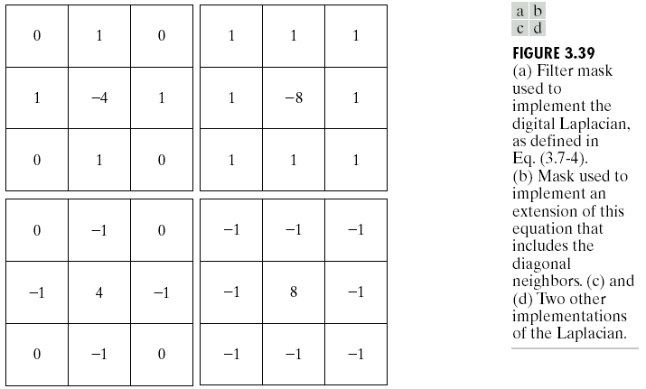
The Laplacian in the Frequency Domain
Recall that the definition of a 2D continuous function is given by
The Laplacian operator
can be approximated by
linear filtering with
masks shown at right
41

Slide 42
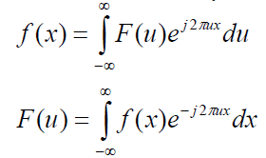
The Laplacian in the Frequency Domain
We want to find the equivalent operator in the frequency domain.
Continuous Fourier transform pair is defined
From the inverse FT, we can derive the following result
42

Slide 43
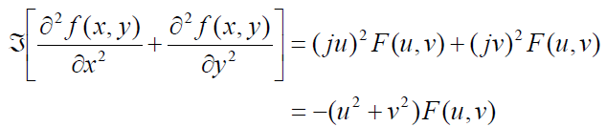
The Laplacian in the Frequency Domain
From the result of the previous slide, it follows that
The Laplacian can be implemented in the frequency domain using the filter
43

Slide 44
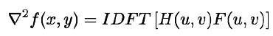
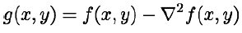
The Laplacian in the Frequency Domain
If f (and F) are of size M×N,this operation shift the center transform so that (u,v)=(0,0) is at point (M/2, N/2) in the frequency rectangle. The filter function is rewritten:
The Laplacian image is obtained by:
Enchancement of the image is achieved using (H(u,v) is negative):
44

Slide 45
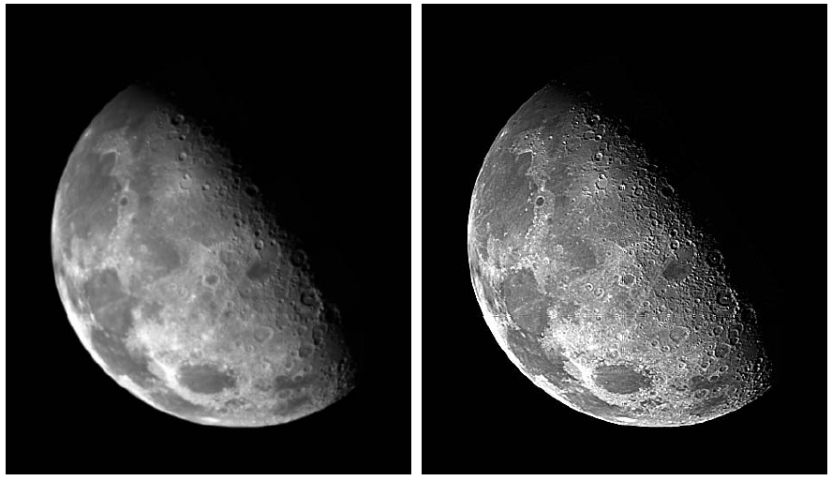
The Laplacian in the Frequency Domain
45

Slide 46
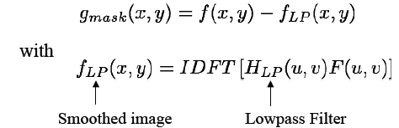
Unsharp Masking, Highboost Filtering and High-Frequency-Emphasis Filtering
Concept: sharpen images by subtracting an unsharp image from the original. The difference is the mask, which is given by
46

Slide 47
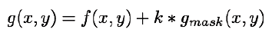
Unsharp Masking, Highboost Filtering and High-Frequency-Emphasis Filtering
then, the output image is
The expression is unsharp masking when k=1
highboost filtering when k>1
Expressed in terms of frequency domain computations involving a lowpass filter:
47

Slide 48
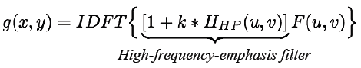
Unsharp Masking, Highboost Filtering and High-Frequency-Emphasis Filtering
We can express the result in terms of a highpass filter
As noted earlier, highpass filters set the dc term to zero, thus reducing the average intensity in the filtered image to 0. The high-frequency-emphasis filter does not have this problem because of the 1 that is added to the highpass filter.
The constant, k, gives control over the proportion of high frequencies that influence the final result..
48

Slide 49
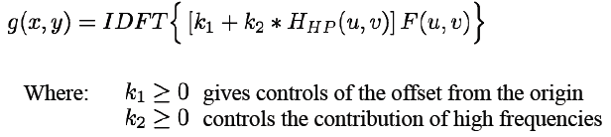
Unsharp Masking, Highboost Filtering and High-Frequency-Emphasis Filtering
A slightly more general formulation of high-frequency-emphasis filtering is the expression
49

Slide 50
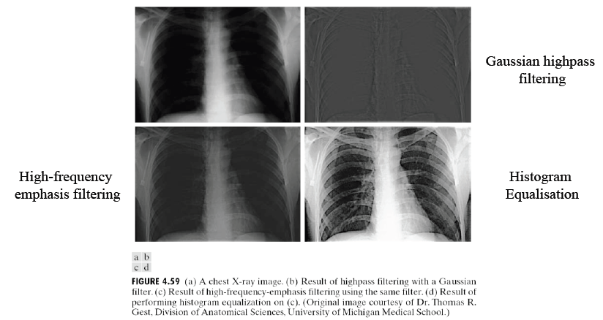
Unsharp Masking, Highboost Filtering and High-Frequency-Emphasis Filtering
50

Slide 51
Selective Filtering
The filter discussed in the previous two sections operate over the entire frequency rectangle. There are application in which it is of interest to process specific bands of frequencies or small regions of the frequency rectangle. Filters in the first category are called bandject or bandpass filters, respectively. Filters in the second category are called notch filters.
51

Slide 52
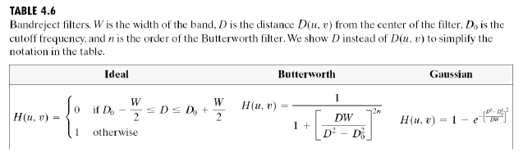
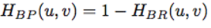
Selective Filtering
Bandreject and Bandpass Filters
A bandpass filter is obtained from a bandreject filter as:
52

Slide 53
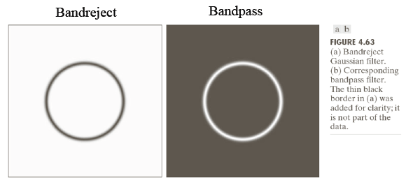
Selective Filtering
Example: Bandreject Gaussian filter
53

Slide 54
Selective Filtering
Notch Filters
Notch filters are the most useful of the selective filters.
A notch filter reject (or pass) frequencies in a predefined neighborhood about the centre of the frequency rectangle
Zero-phase-shift filters must be symmetric about the origin, so a notch with center at (u₀,v₀) must have a corresponding notch at location (-u₀,-v₀).
54

Slide 55
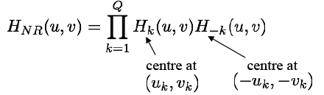
Selective Filtering
Notch Filters
Notch reject filters are constructed as products of highpass filters whose centers have been translated to the centers of the notches. The general form is:
Where H_{k}(u,v) and H_{-k}(u,v) are highpass filters whose centers are at (u_{k},v_{k}) and (-u_{k},-v_{k}) , respectively
55

Slide 56
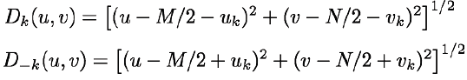
Selective Filtering
These centers are specified with respect to the center of the frequency rectangle, (M/2,N/2). The distance computations for each filter are thus carried out using the expressions
56

Slide 57
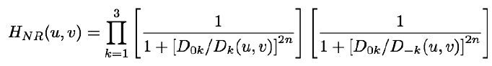
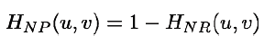
Selective Filtering
Example: Butterworth notch reject filter of order n, containing 3 notch pairs:
Where, D_{k} and D_{-k} are as before. The constant D_{0k} is the same for each pair of notches, but it can be different for different pairs.
A Notch Pass filter (NP) is obtained from a Notch Reject filter (NR) using:
57

Slide 58
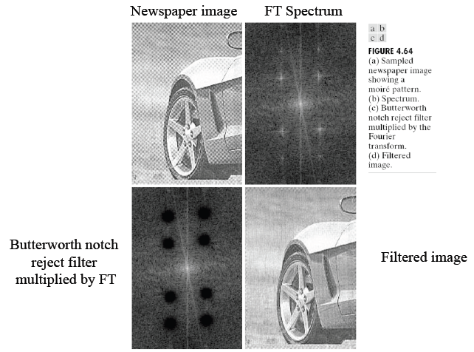
Selective Filtering
58

Slide 59
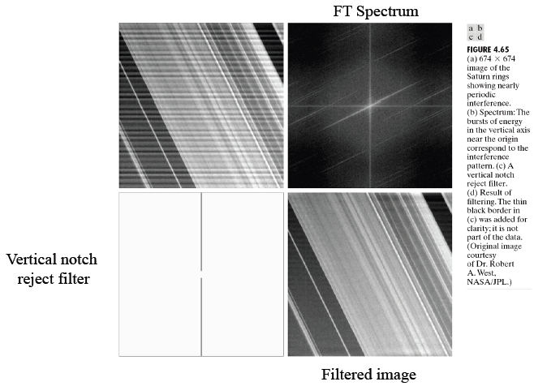
Selective Filtering
59

Slide 60
Summary
In this lecture, we have learned
Basics of filtering in the frequency domain
Image smoothing using frequency domain filters
Image sharpening using frequency domain filters
Selective filtering
60

Slide 61
Homework
Exercise 1: Fourier transform the sequence f(0) = 2, f(1) = 3, f(2) = 4, f(3) = 4. Then calculate the inverse Fourier transform and compare the result with the original sequence.
Exercise 2: Given the image with the size 2X2 in which pixel values are f(0,0)=1, f(0,1)=2, f(1,0)=0, f(1,1)=3, computer the Fourier magnitudes and phase angles of the image.
Exercise 3: P330 problem 4.31
61

Slide 62
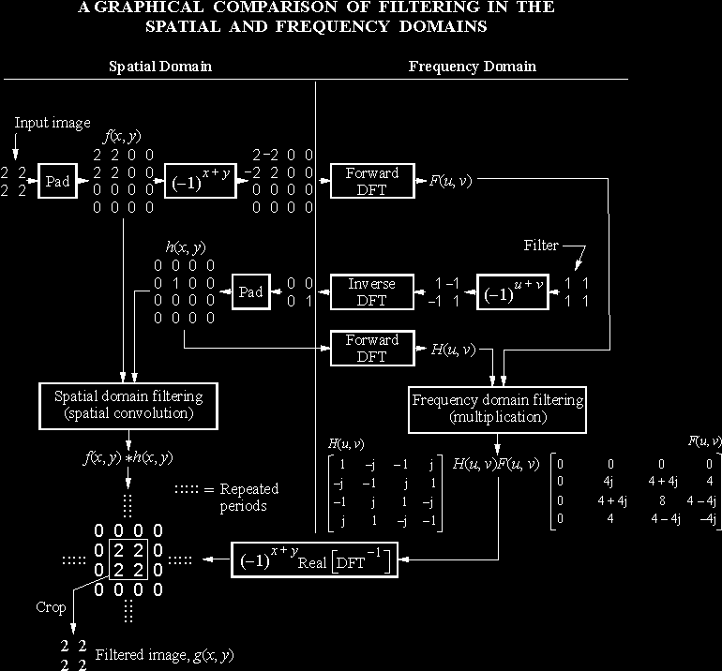
Homework
62

